Slide 1

LINUX IPC
ASHWIN MURALI 05/06/20
Notes:
We are going to be focusing on the classification, how IPCs work in general and factors that should be considered while choosing one over another rather than going into too much detail about any single one. I figured if I did that no one would remember anything and it would be like reading a man page which isn’t terribly useful.

Slide 2
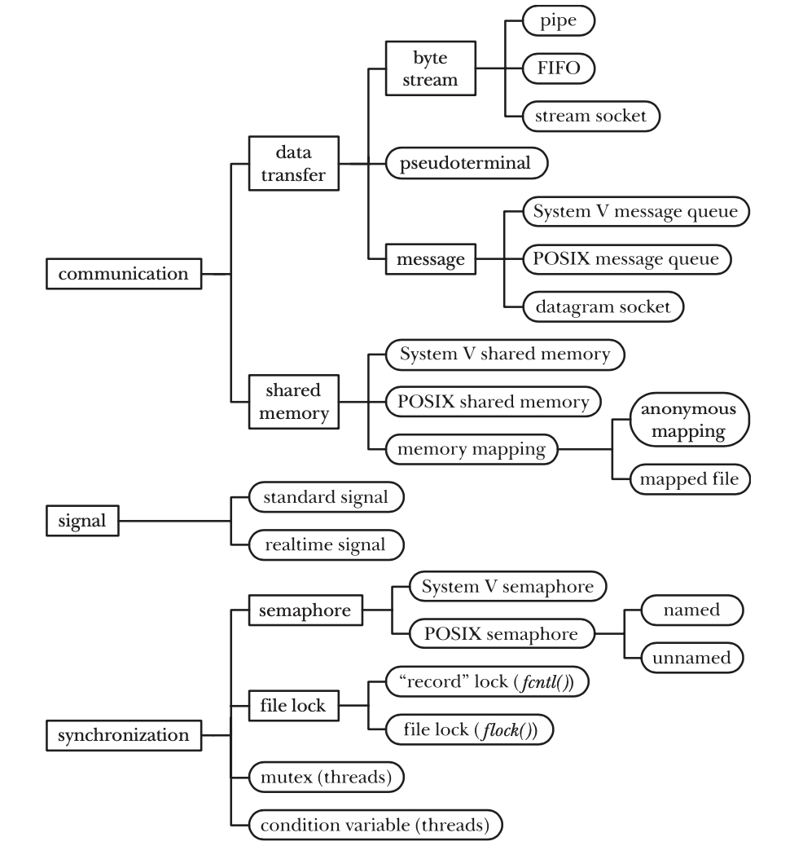
IPC CLASSIFICATION
Similar IPC facilities evolved on different UNIX variants, and later came to be ported to other UNIX systems. For example, FIFOs were developed on System V, while stream sockets were developed on BSD.
New facilities have been developed to address design deficiencies in similar earlier facilities.

Slide 3
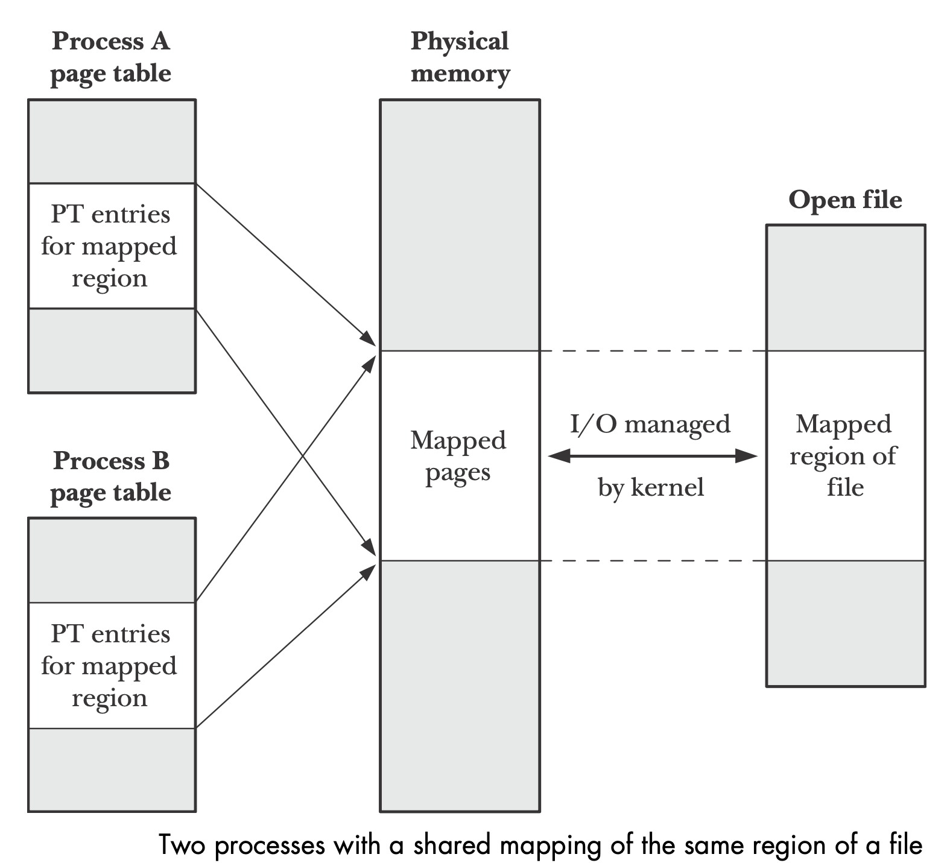
SHARED MEMORY
Some of the performance benefits offered by shared memory due to the lack of need for systems calls is offset by the need to synchronise read and write operations (semaphores).
Data in shared memory is visible to all processes that share it and reads are not destructive.
Shared memory is identified by a unique integer, the Shared memory ID.

Slide 4
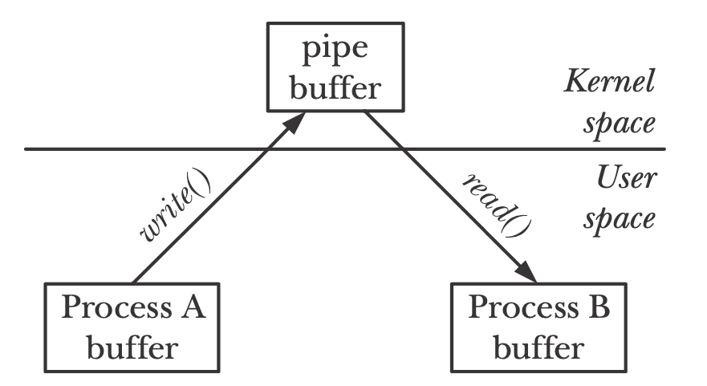
DATA TRANSFER
Byte stream: The data exchanged is an undelimited byte stream. The size of the bytes read and bytes written has no direct relation.
Message: The data exchanged takes the form of delimited messages. Each read operation reads a whole message written by a writer.
Pseudoterminals: They are virtual devices that provide an IPC channel.

Slide 5
Data transfer vs Shared memory
Data transfer requires 2 data transfers between the kernel and user memory. One for reading and once for writing.
Shared memory is a chunk of user space memory shared between two processes.
Although a data-transfer facility may have multiple readers, reads are destructive. A read operation consumes data and is not available to other processes.
Synchronisation between the reader and writer processes is automatic. If a reader attempts to fetch data from a data-transfer facility that currently has no data, then the read operation will be blocked until data is written.

Slide 6
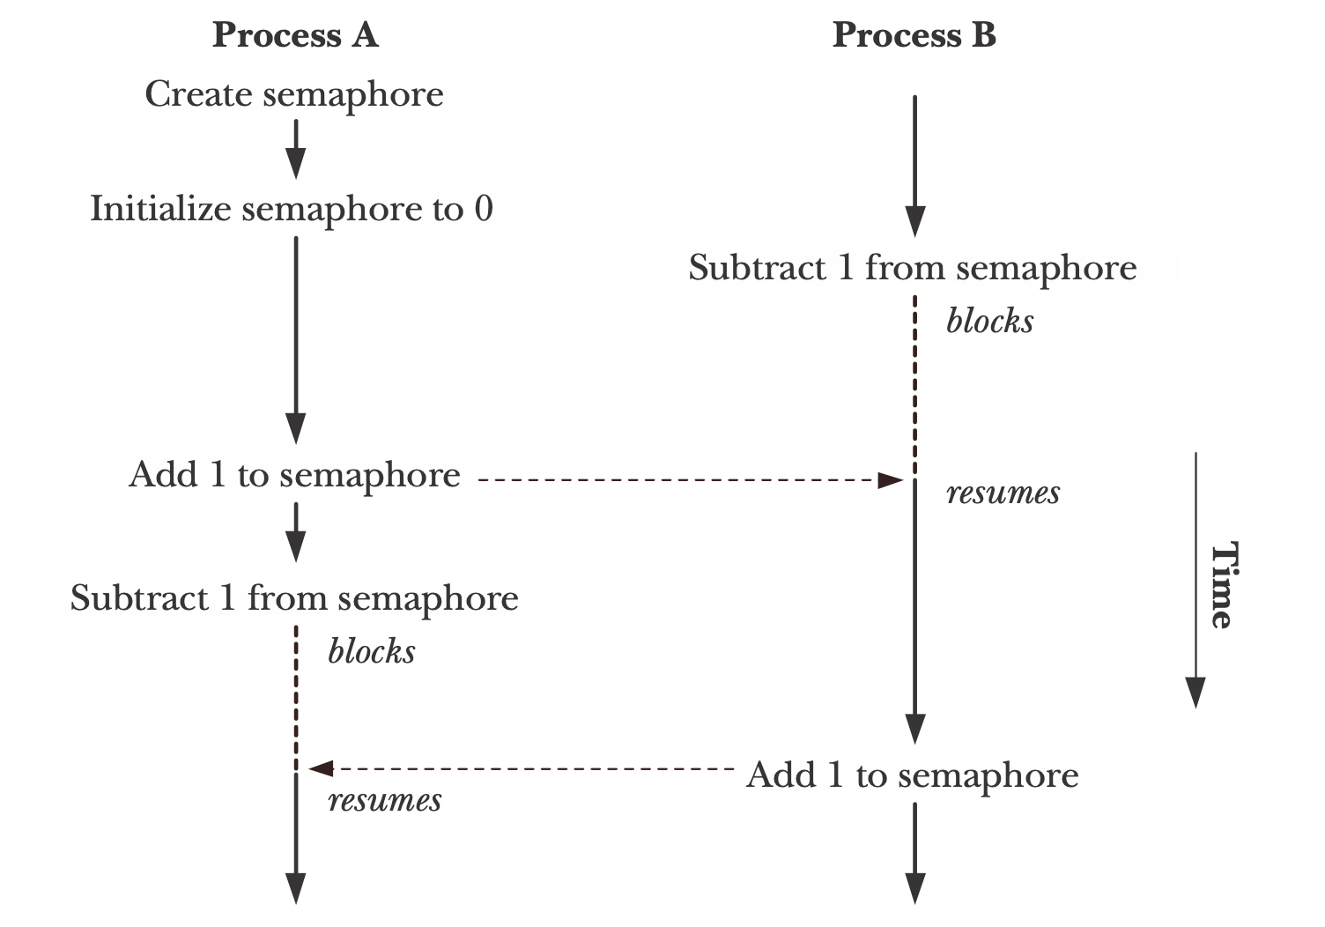
SYNCHRONIZATION
Semaphores: A semaphore is a kernel maintained integer whose value is never permitted to fall below 0. If a process attempts to decrease the value of a semaphore below 0 the operation is blocked until it’s value is high enough.
File locks: Explicitly designed to coordinate the actions of multiple processes operating on the same file. Any number of processes can hold a readlock on a file but when a process acquires a write lock, no other lock can be obtained on the same file.
Mutexes and condition variables: These synchronization facilities are used with POSIX threads. When a thread calls condition wait, the caller is put into the queue of that condition variable. When a thread calls condition signal, if there are threads waiting in that condition variable's queue, one of them is released.

Slide 7
Threads
IPCs can also be used with threads but are seldom used because of global variables.
Notes:
Except synchronisation techniques.

Slide 8
NETWORK COMMUNICATION
Of all the IPC methods we have seen in the classification only sockets permit processes to communicate over a network.
Sockets are generally used in one of two domains: the UNIX domain, which allows communication between processes on the same system, and the Internet domain, which allows communication between processes on different hosts connected via a TCP/IP network.
Often, only minor changes are required to convert a program that uses UNIX domain sockets into one that uses Internet domain sockets, so an application that is built using UNIX domain sockets can be made network-capable with relatively little effort

Slide 9
PORTABILITY
The POSIX IPC facilities are not as widely available as their System V IPC counterparts, especially on older UNIX systems. An implementation of POSIX message queues and full support for POSIX semaphores have appeared on Linux only in the 2.6.x kernel series. So from a portability point of view, System V IPC may be preferred to POSIX IPC.

Slide 10


Slide 11
Process persistence
A process-persistent IPC object remains in existence only as long as it is held open by at least one process. If the object is closed by all processes, then all kernel resources associated with the object are freed, and any unread data is destroyed. Pipes, FIFOs, and sockets are examples of IPC facilities with process persistence.

Slide 12
Kernel persistence
A kernel-persistent IPC object exists until either it is explicitly deleted or the system is shut down. The lifetime of the object is independent of whether any process holds the object open. This means that, for example, one process can create an object, write data to it, and then close it (or terminate). At a later point, another process can open the object and read the data.

Slide 13
File-System persistence
An IPC object with file-system persistence retains its information even when the system is rebooted. The object exists until it is explicitly deleted. The only type of IPC object that demonstrates file-system persistence is shared memory based on a memory-mapped file.

Slide 14
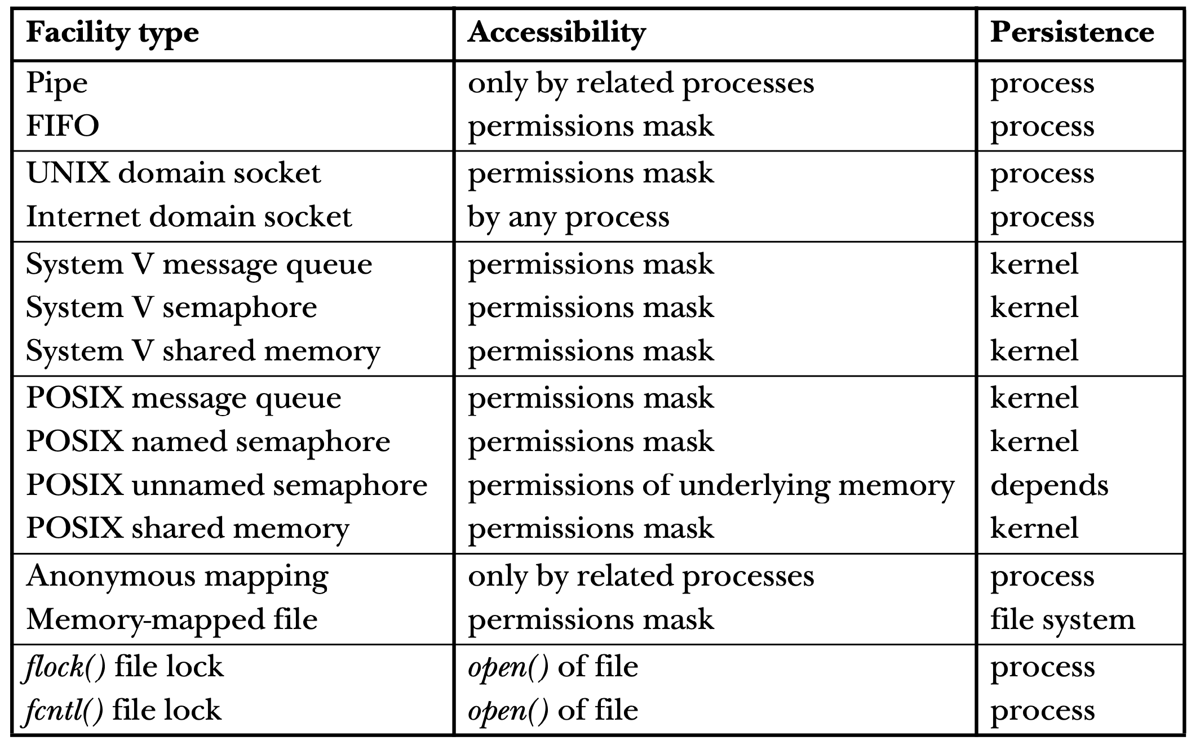

Slide 15


Slide 16
The performance of an IPC facility may not be a significant factor in the overall performance of an application, and it may not be the only factor in determining the choice of an IPC facility.
The relative performance of the various IPC facilities may vary across UNIX implementations or between different versions of the Linux kernel.
Most importantly, the performance of an IPC facility will vary depending on the precise manner and environment in which it is used. Relevant factors include the size of the data units exchanged in each IPC operation, the amount of unread data that may be outstanding on the IPC facility, whether or not a process context switch is required for each unit of data exchanged, and other load on the system.

Slide 17


Slide 18
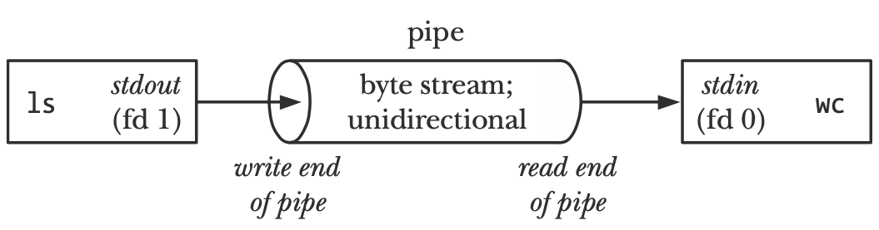
PIPES
A pipe is a byte stream. This means that there is no concept of messages or message boundaries when using a pipe. The process reading from a pipe can read blocks of data of any size, regardless of the size of blocks written by the writing process.
The data passes through the pipe sequentially, bytes are read from a pipe in exactly the order they were written. It is not possible to randomly access the data in a pipe using lseek().
If multiple processes are writing to a single pipe, then it is guaranteed that their data won’t be intermingled if they write no more than PIPE_BUF bytes at a time.

Slide 19
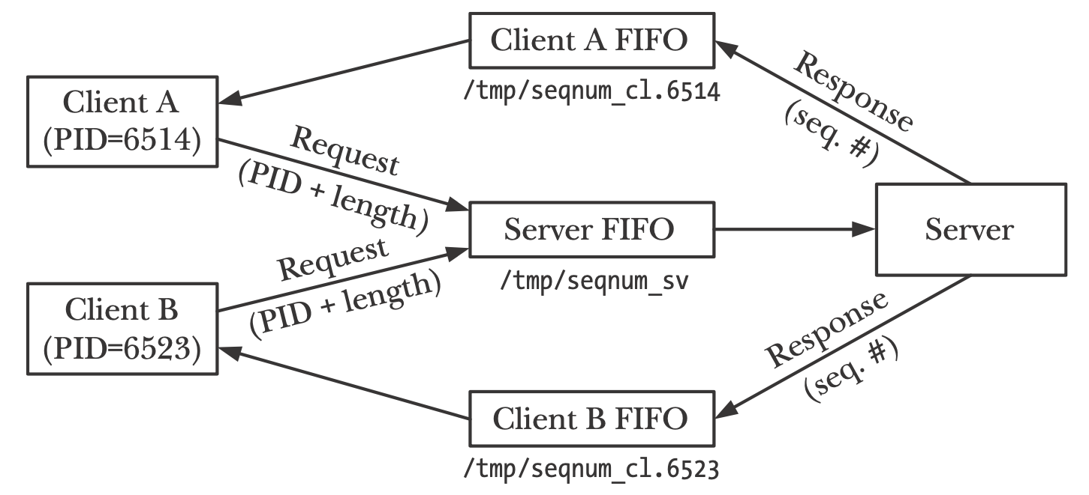
FIFO
Semantically, a FIFO is similar to a pipe. The principal difference is that a FIFO has a name within the file system and is opened in the same way as a regular file. This allows a FIFO to be used for communication between unrelated processes (e.g., a client and server).
Once a FIFO has been opened, we use the same I/O system calls as are used with pipes and other files. Just as with pipes, a FIFO has a write end and a read end, and data is read from the pipe in the same order as it is written. This fact gives FIFOs their name: first in, first out. FIFOs are also some-times known as named pipes.
As with pipes, when all descriptors referring to a FIFO have been closed, any outstanding data is discarded.

Slide 20
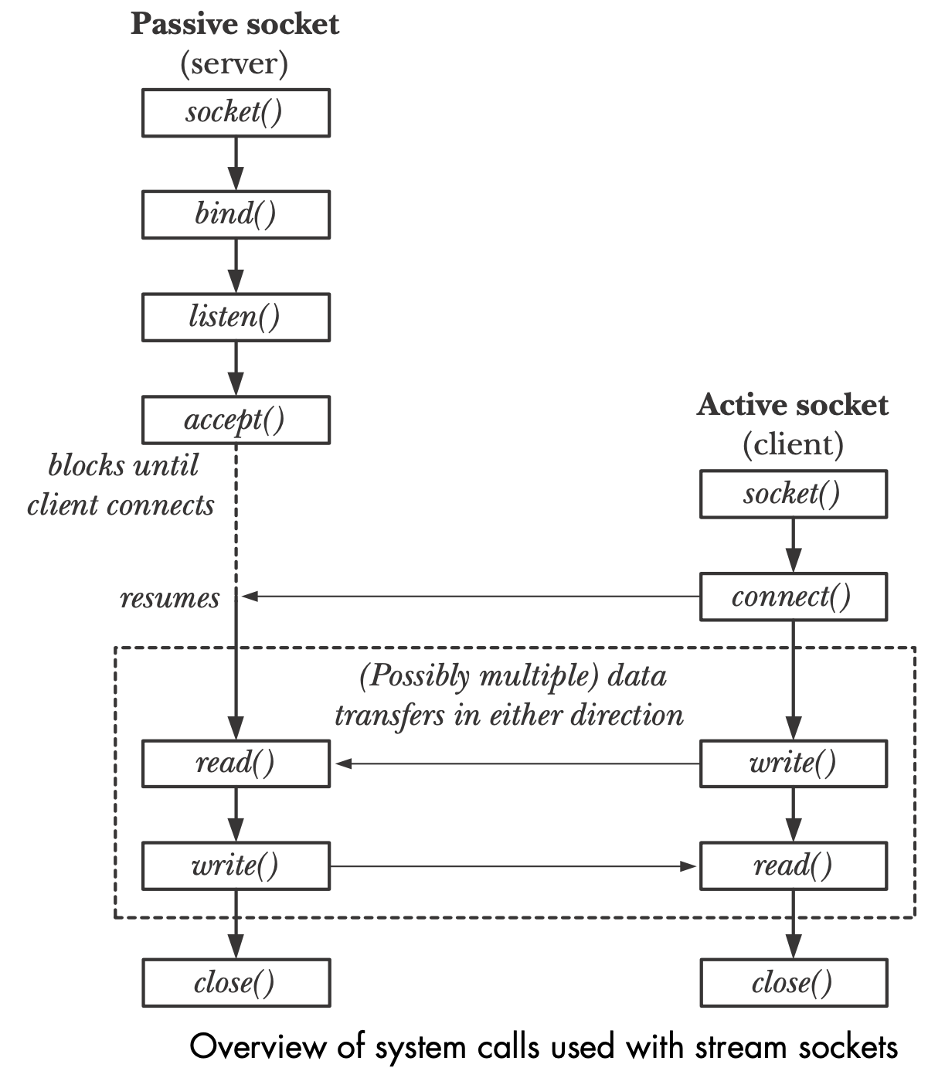
SOCKETS
Sockets are a method of IPC that allow data to be exchanged between applications, either on the same host (computer) or on different hosts connected by a network.
Each application creates a socket. A socket is the “apparatus” that allows communication, and both applications require one.
The server binds its socket to a well-known address (name) so that clients can locate it.

Slide 21
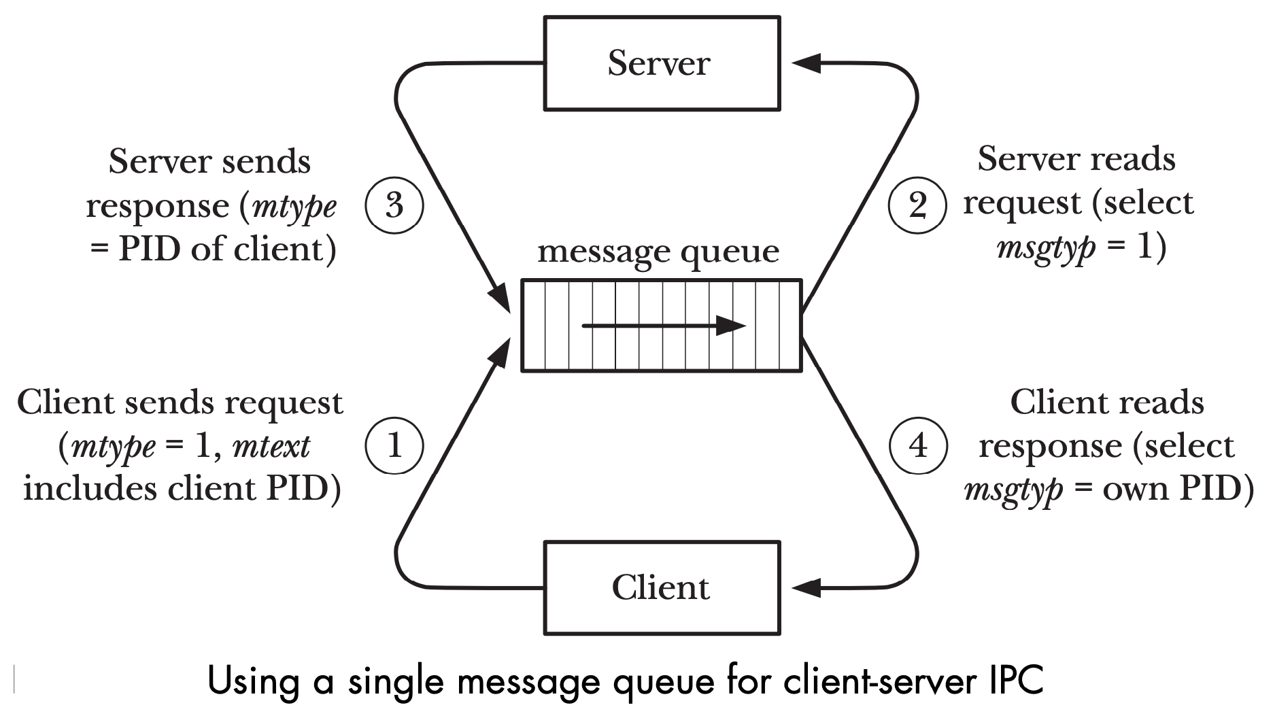
MESSAGE QUEUES
Message queues allow processes to exchange data in the form of messages. Although message queues are similar to pipes and FIFOs in some respects, they also differ in certain ways.
Communication via message queues is message-oriented; that is, the reader receives whole messages, as written by the writer. It is not possible to read part of a message, leaving the remainder in the queue, or to read multiple messages at a time. This contrasts with pipes, which provide an undifferentiated stream of bytes (i.e., with pipes, the reader can read an arbitrary number of bytes at a time, irrespective of the size of data blocks written by the writer).
In addition to containing data, each message has an integer type. Messages can be retrieved from a queue in first-in, first-out order or retrieved by type.

Slide 22
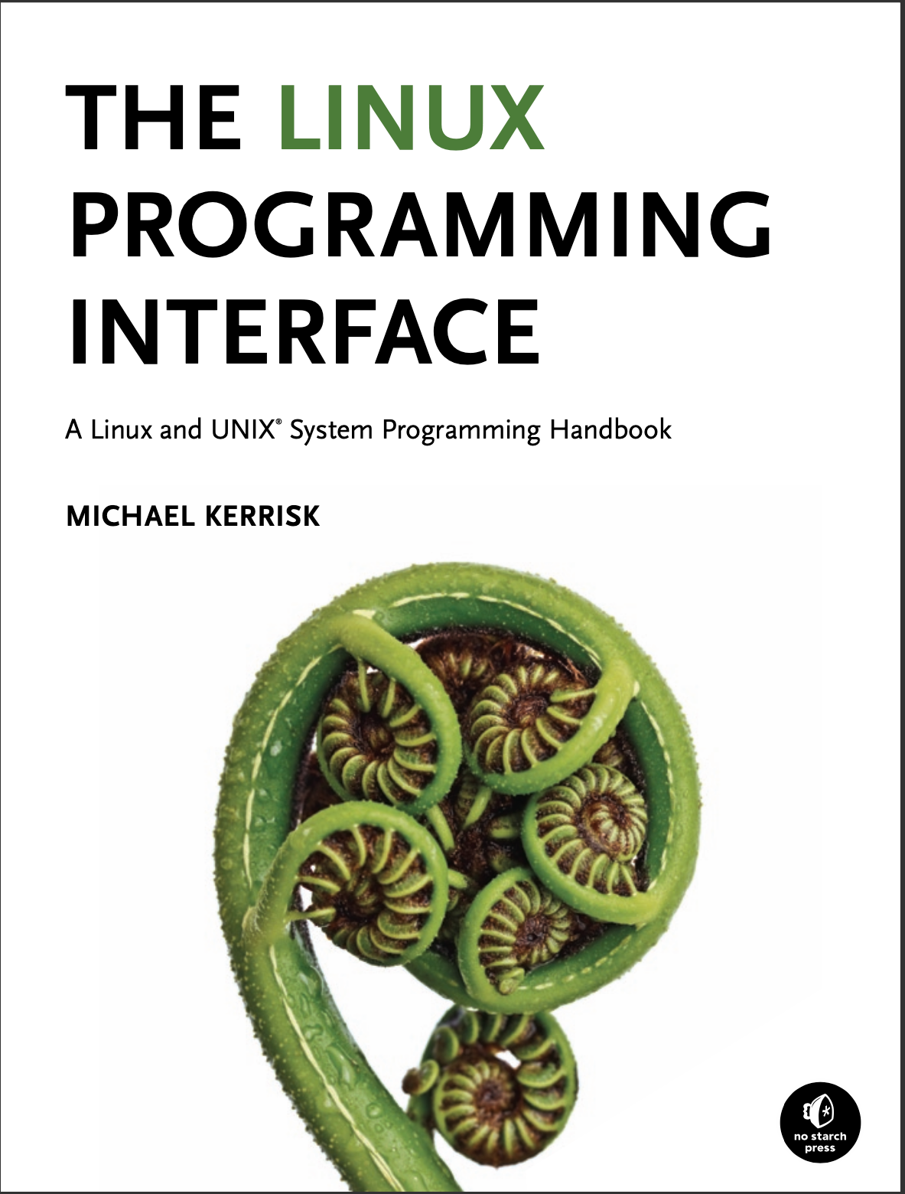
CREDITS

